Slide 1
A dashboard for Finance Ministers to support the implementation of long-term strategies
User booklet
December 2022

Slide 2

Acknowledgements
I4CE – Institute for Climate Economics, is a non-profit association with expertise in economics and finance. I4CE contributes to the fight against climate change by informing the public policy debate and supporting public and private decision-makers
This project has received support from the 2050 Pathways Platform, hosted at the European Climate Foundation (ECF).

Slide 3
Link to the dashboard
The dashboard template is available as an Excel file on I4CE’s website
A report presenting insights from the research underlying the dashboard is available here
We will release updated versions of the template as we receive feedback from countries and practitioners.
We are hoping to launch a pilot study to put this dashboard into practice in the coming year. In the meantime, please do not hesitate to get in touch with us.

Slide 4
User booklet contents
Context and objective
Key interview takeaways
Dashboard overview
Tab details:
LTS overview
Climate investments
Policies & financing
Macroeconomic implications
How to fill the dashboard template in practice

Slide 5
Context and objectives

Slide 6
Context
Long-Term Strategies (LTS) are key documents for countries to fulfil their climate objectives
As of November 2022, 55 countries had submitted their LTS to the UNFCCC
LTS implementation remains challenging:
Need for large-scale yet targeted actions
Whole of government approach
Multiple time horizons
The involvement of Finance Ministries in the implementation of LTS is key to ensure:
Climate investments are unlocked
Public funding is available to support effective climate action
The economic implications of the transition are anticipated, managed, and benefits are maximised
For more details on the context, please see the report available here

Slide 7
Dashboard objective and requirements
Objective of the dashboard:
To provide Finance Ministers with a dashboard to contextualize national long-term low-emission strategies (LTS) to be used by Finance Ministries in developing and developed countries
Dashboard requirements
Indicators in the dashboard should be relevant, robust, and realistically fillable
The dashboard should highlight key indicators and insights
Focus on the financial aspects of the transition
The dashboard should be user-friendly
Indicators should be modulable by users to adjust for different national contexts
Indicators should be modulable over different timeframes

Slide 8
Methodology
The dashboard template was developed following these steps:
Literature review:
Set the scope of the project
Identify existing indicators linking public finance management and climate strategies
Take stock of missing elements in existing studies and tools
Interviews with key stakeholders:
Semi-guided interviews with representatives from the Ministries of Finance of 6 countries
Interviews with representatives from civil society organizations
Internal and external reviews:
Presentation of the final tool to a set of interviewees from phase 2
Presentation of the tool to representatives from 8 international organizations

Slide 9
Dashboard overview

Slide 10
Dashboard structure
Investment needs assessment: how projected ‘real economy’ changes translate into sectoral climate investment needs
Key macroeconomic implications of the LTS: growth, income, prices, debt, employment, trade balance, foreign exchange, etc.
LTS overview
Climate investments
Policies & Financing
Macro implications
Salient elements from the LTS:
LTS objectives and milestones
Projected real economy changes
Key challenges and levers for the transition
Implications of the LTS for the national budget:
Overview of policies in place to trigger climate investments
Estimates of the volumes of public funding which support / go against LTS objectives
Available & potential resources which can be mobilized to support LTS implementation

Slide 11
Tab – LTS overview

Slide 12
LTS overview
Dashboard structure
LTS overview
Climate investments
Policies & Financing
Macro implications
LTS are not always well-known to officials working in Ministries of Finance. This tab presents, in a succinct manner, LTS elements that are key to Ministries of Finance’s work.
The purpose of this tab is to highlight where efforts will be most needed according to the LTS:
Mitigation: the country’s current and projected contribution to climate change, GHG emission reductions targets, expected mitigation challenges and levers
Adaptation: current and projected socio-economic impacts of climate change, adaptation objectives, expected challenges and levers
Development objectives
This tab could also serve to highlight where the LTS may not provide sufficient information; it also prepares the translation of LTS targets and objectives into investment needs
Notes:
The purpose of this tab is not to provide a cost-benefit analysis of the transition

Slide 13
LTS overview Key charts and indicators
LTS overview
Climate investments
Policies & Financing
Macro implications
Key development objectives from the LTS:
XXX
XXX
XXX
Key adaptation objectives from the LTS:
XXX
XXX
XXX
Key mitigation objectives
Including objectives regarding climate-harmful activities
XXX
XXX XXX

Slide 14
Tab – Climate investments

Slide 15
Climate investments
LTS overview
Climate investments
Policies & Financing
Macro implications
A country’s GHG emissions are directly linked to the type of equipment and infrastructure on the ground.
The transition to a low-carbon economy will materialize in visible, real economy investments: energy-efficient renovations, renewable energy power plants, electric vehicles replacing ICE vehicles on roads, new low-carbon urban transport networks, etc.
Only a fraction of this equipment / infrastructure is replaced every year, making the timing of climate investments crucial to avoid the risk of carbon lock-in.
This tab proposes to track investments consistent with LTS climate goals (climate investments) and counterproductive investments e.g. in fossil fuels (harmful investments).

Slide 16
Climate investments Key charts and indicators
LTS overview
Climate investments
Policies & Financing
Macro implications

Slide 17
Climate investments Expected challenges
Detailed information on the sectoral transformations needed in the real economy
The current LTS may not provide sufficient levels of detail
The computation of investment needs relies on methodological choices:
Definitions: what qualifies as climate mitigation, ‘climate adaptation’ and ‘climate-harmful’
Costs hypotheses: could be based on current costs and projections of how these will evolve over time (technological progress, economies of scale, etc.)
It is possible to obtain order of magnitude estimates with rough or partial data, and loose definitions, and to revisit these elements at a later stage
The focus should be on the key sectors / activities identified in the LTS

Slide 18
Tab – Policies and financing

Slide 19
Policies & financing
LTS overview
Climate investments
Policies & Financing
Macro implications
This tab details the means and implications of implementing LTS for public finances.
It covers current, planned, and proposed policies to trigger climate investments and real economy changes required for the implementation of the LTS, as well as the corresponding projected volumes of public spending.
The tab also proposes to track climate-harmful public spending to highlight areas for reform, or suggest complementary, reparative policies.
Current, projected and potential sources of revenue for the transition are laid out and split between fiscal revenues, debt instruments (e.g. bonds), and international loans and aid.

Slide 20
Policies & financing Key charts and indicators
Dashboard structure
LTS overview
Climate investments
Policies & Financing
Macro implications

Slide 21
Policies & financing Expected challenges
Recording all LTS relevant policies
National policies and policy options to trigger climate investments are multiple and vary significantly in scope (nation-wide, sectoral, project based..) and intent (directly / indirectly trigger investments)
Start by recording the most significant policies
Tracking public spending associated with LTS implementation and goals
Easier if a taxonomy or common baseline have been developed by the country
Alternatively, for countries who have not engaged in green budgeting, the types of public policies could be used as an entry point to retrieve the order of magnitude of public funding supporting LTS implementation
Identifying climate-harmful public spending
Will require definitions, baselines and political support

Slide 22
Tab – Macroeconomic implications of the LTS

Slide 23
Macroeconomic implications Purpose and overview
LTS overview
Climate investments
Policies & Financing
Macro implications
The real economy changes needed to achieve LTS targets are likely to – positively or negatively – impact the structure of the economy: growth, income levels, key sectors, jobs, imports, exports, debt, foreign exchange, etc.
The purpose of this tab is to compare the macroeconomic implications of implementing the LTS to the business-as-usual (BAU) scenario (i.e., assuming no LTS implementation)
For countries already engaged in modelling, this tab will provide a synthesis of key indicators to monitor the macroeconomic impacts of LTS implementation.
This tab comprises:
A list of main indicators derived from the existing literature on the macroeconomic implications of the low-carbon transition
Additional indicators based on the country’s development priorities as laid out in the LTS.

Slide 24
Macro implications Key indicators
Dashboard structure
LTS overview
Climate investments
Policies & Financing
Macro implications
OUTPUT
SOCIOECONOMIC INDICATORS
Chart / numbers BAU vs. LTS:
National output, growth, key sectors, energy intensity, carbon intensity of energy
Chart / numbers BAU vs. LTS:
Income levels, poverty, inequality employment, labour productivity
Chart / numbers BAU vs. LTS:
Food and energy prices, inflation, price volatility
Chart / numbers BAU vs. LTS:
Debt
PRICES
DEBT
Chart / numbers BAU vs. LTS:
Key imports, key exports, trade balance, energy trade balance
TRADE
Chart / numbers BAU vs. LTS:
Foreign exchange
CURRENCY

Slide 25
Macro implications Expected challenges
Coming up with macroeconomic indicators for the BAU and the LTS scenarios could require significant modelling
We assume that the macroeconomic modelling is done outside the dashboard
The tab will therefore be easier to fill for countries already engaged in macroeconomic modelling
For countries without running macroeconomic models:
The tab provides information on existing evidence regarding the impacts of the transition on macroeconomic variables
The dashboard can be used to select which macroeconomic indicators to track

Slide 26
How to fill the dashboard template in practice

Slide 27
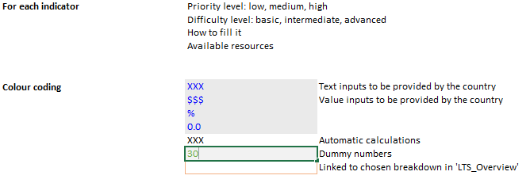
How to fill the dashboard in practice Guidelines
The dashboard is easily fillable, no macros are used in the file
Graphs are automatically generated
It is possible to leave indicators blank with no effect on the structure of the dashboard
Inputting information and data in the dashboard

Slide 28
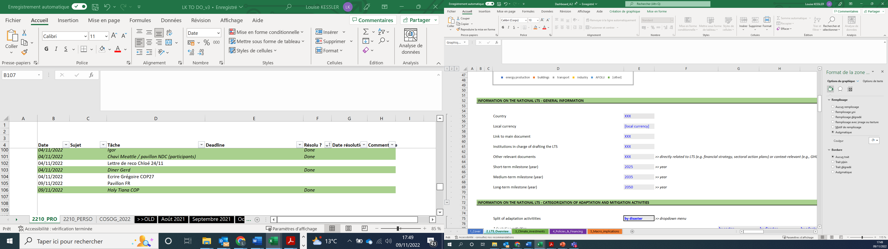
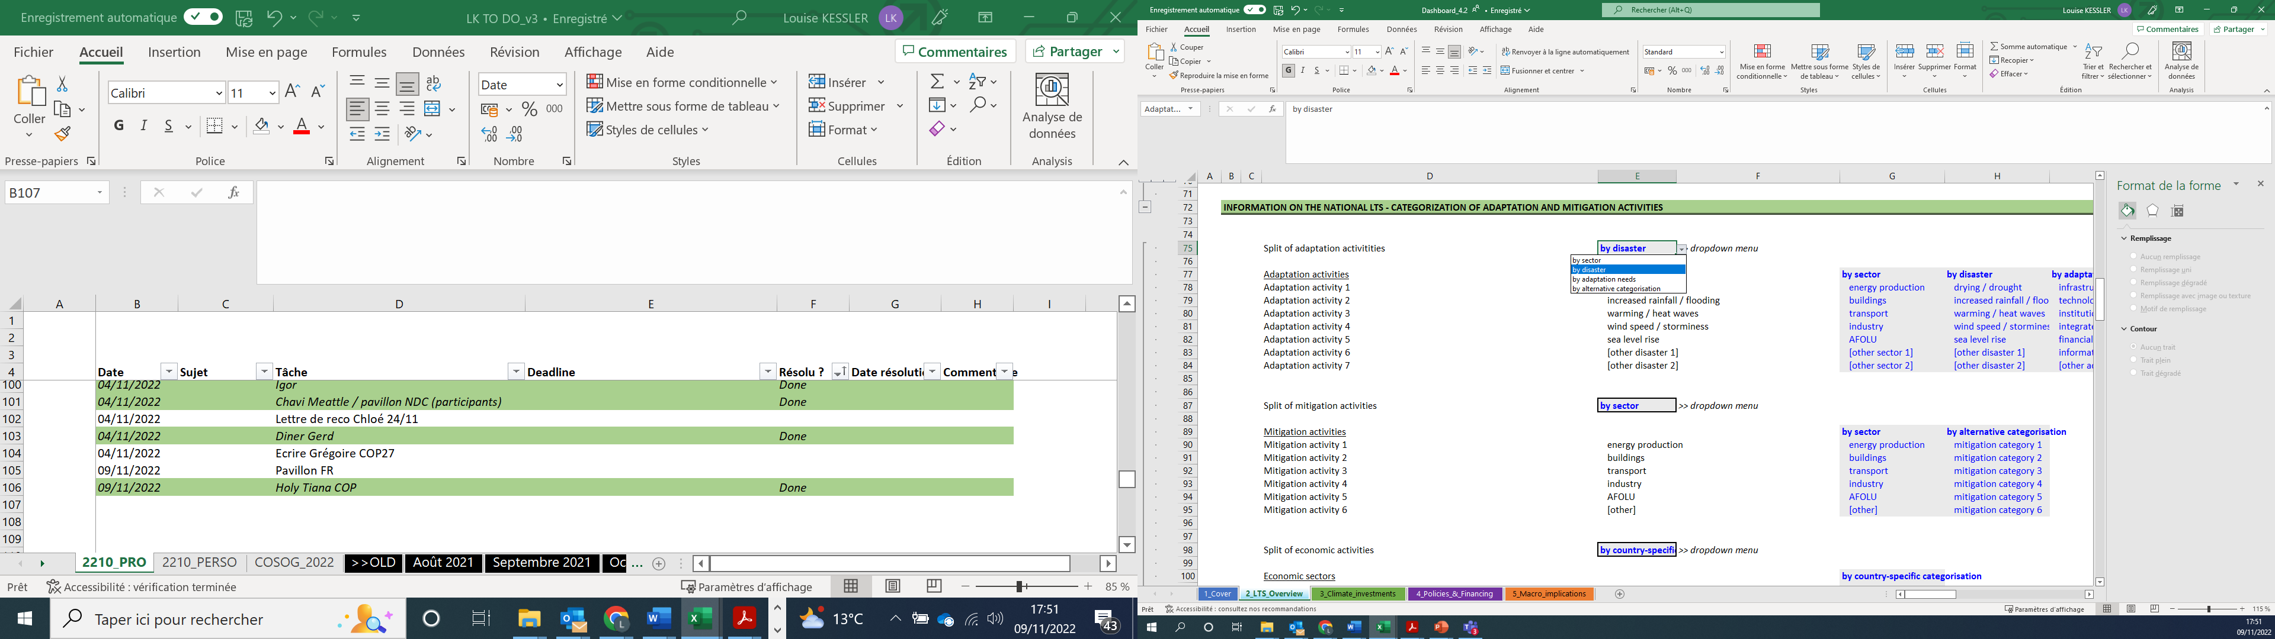
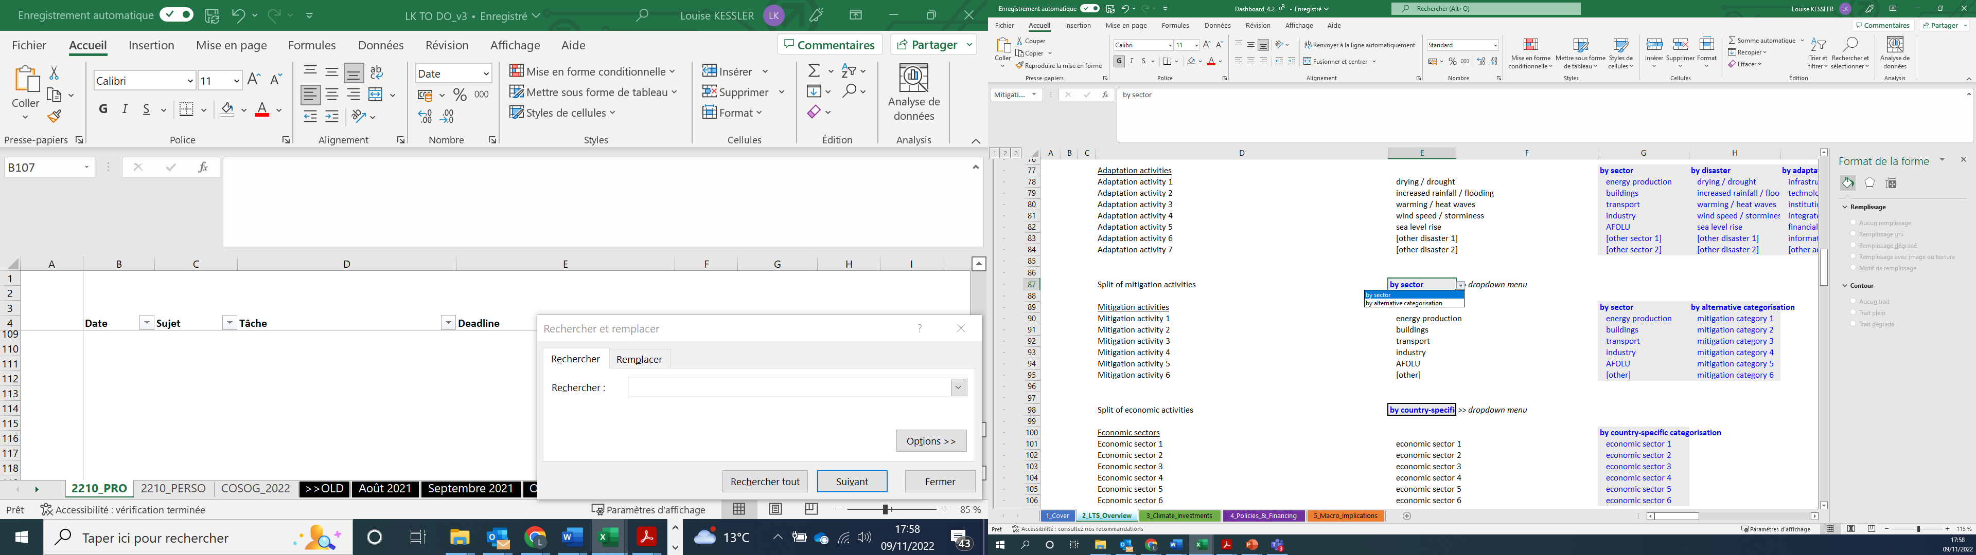
How to fill the dashboard template in practice Tailoring the template to the national context
The tab "LTS_Overview" allows users to input key elements including currency, units, key LTS targets
Filling this tab is essential before proceeding to filling the other tabs
The breakdown of mitigation and adaptation activities can be tailored to reflect the national context and existing categories used in national documents
Dropdown menus allow to choose the format

Slide 29
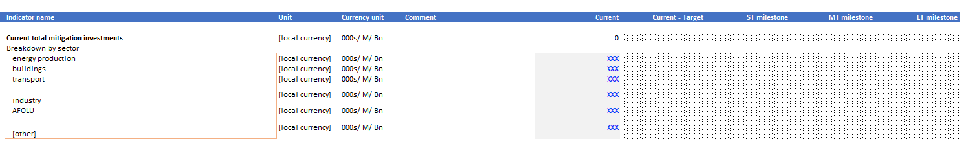
How to fill the dashboard template in practice Filling in indicators
For tabs 3_Climate_investments, 4_Policies & Financing, and 5_Macro implications
Time horizons are linked to the ‘LTS overview’ tab
‘Current’, ‘Current – Target’ + short-, medium- and long-term milestones from the LTS
Currency units are linked to the ‘LTS overview’ sheet
Cells to be filled in are shaded in grey with a blue font (for inputs); results of automatic calculations are in black
Comments can be added by users in column G

Slide 30
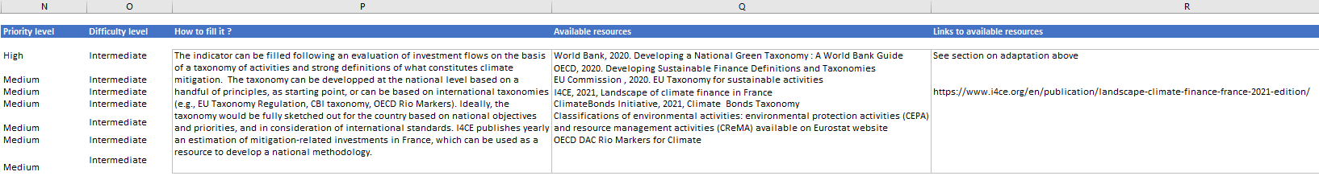
How to fill the dashboard template in practice Additional information on indicators
For tabs 3_Climate_investments, 4_Policies & Financing, and 5_Macro implications
The levels of priority and difficulty associated with each indicator are provided in columns M and O. This information should help users decide upon which indicators to fill first, in consideration of their national context.
Columns P, Q to R provide information that can help users fill in indicators, and list resources which can be helpful.
Example:

Slide 31
Questions?
Please get in touch with us:
louise.kessler@i4ce.org
chloe.boutron@i4ce.org

